Slide 1

StyleSurfer
Bringing affordable & Sustainable fashion to everyone
Prepared By :-
Harshad Soyaliya – 92200938212
Purav Chauhan – 92200938220
Mansi Kadvani – 92200938221
Bhumika Kanzariya – 92200938234
Jay Kaneriya - 92200938239
Guided By :-
Prof. Foram N Chovatiya
Designation : Assistant Professor
1

Slide 2
Content
Abstract
Objectives
Problems
Methods
System Design ( Diagrams )
Results
Future Plans
2

Slide 3
Abstract
3

Slide 4
StyleSurfer is an affordable and eco-friendly fashion rental platform that lets people wear stylish, high-quality clothes without buying them. Based in Rajkot, it helps reduce fashion waste by encouraging reuse, making trendy and premium outfits more accessible to everyone.
Built using Python and Django for the backend and HTML, CSS, Bootstrap, and JavaScript for the website, StyleSurfer ensures a smooth and user-friendly experience.
4

Slide 5
Customers can easily sign up, manage their profiles, browse outfits with advanced filters, and rent clothes with flexible options like extended rentals and damage protection. Unique features like the Buy Back option (where users can make a request to customized outfits and if they want to return then they can in fixed duration), Reselling (where pre-rented outfits are sold at a discount), a fun Spin-to-Win discount game. Sellers can list and manage products, track sales, and receive secure payments, while delivery partners get automated order assignments, an easy-to-use dashboard, and navigation support for smooth deliveries.
5

Slide 6
By combining technology, sustainability, and convenience, StyleSurfer makes fashion more affordable and eco-friendly while benefiting customers, sellers, and delivery partners.
…
6

Slide 7
Objectives
7

Slide 8
01
02
Affordability
Provide a platform where customers can rent high-quality and branded clothes at an affordable price, making fashion accessible to everyone.
Sustainability
Encourage the reuse of clothes to reduce textile waste, save water, and promote circular fashion for a more eco-friendly future.
8

Slide 9
03
04
Enhanced Shopping Experience
Offer multiple features such as reselling, selling with us, buy-back options, and a Spin-to-Win reward system to improve the overall shopping experience.
Seamless User Experience
Ensure a smooth and user-friendly interface for customers, sellers, and delivery partners. Customers get easy navigation, sellers can effortlessly list and manage products, and delivery partners have streamlined access to orders, all with a visually appealing design.
9

Slide 10
Problems
10

Slide 11
…
The fashion industry generates a massive amount of waste, with many outfits being discarded after just one use. While fashion rental platforms provide a sustainable alternative, they come with several limitations. Size inclusivity is a major challenge, as many platforms do not offer a wide range of sizes, making it difficult for all customers to find the right fit. Additionally, rental websites lack resale and buy-back options, preventing users from reselling or customizing rented outfits once they are no longer needed.
11

Slide 12
Another major issue is the lack of customer engagement and rewards. Existing platforms do not offer interactive features like discounts, loyalty programs, or gamified experiences, making the rental process less appealing. Furthermore, buying designer clothes for one-time use remains expensive, leaving fashion lovers with limited affordable options.
To address these issues, there is a need for a rental platform that offers size-inclusive options, resale and buy-back features, and engaging reward systems, ensuring a more sustainable and enjoyable fashion experience for all users.
12

Slide 13
Methods
13

Slide 14
Technology
Backend :
Python , Django
Frontend :
HTML , CSS , JS , Bootstrap
14

Slide 15
User Roles
Customers :
Customers can browse and rent stylish outfits for various occasions, return them after use, or purchase them if they wish to own them. Boutique owners and shop owners can also sell their clothes. Customers can manage their orders, request refunds, and cancel bookings if needed. The platform offers a Spin-to-Win feature where they can earn and redeem vouchers for discounts. Additionally, with the Buy-Back option, they can customize outfits and later return them in a 20 days ( if want ).
15

Slide 16
Sellers :
Sellers can list their clothing items for rent or sale, add product details, update availability, and manage orders. They manage buy back requests . Sellers also manage transactions. Additionally, they can update their account details, ensuring smooth business management.
16

Slide 17
Delivery Partners :
Delivery partners handle order pickups and deliveries, collecting outfits from sellers and delivering them to customers. They also manage return pickups and update order statuses such as picked up or delivered. A dashboard allows them to track earnings, view completed deliveries, and manage their profiles, including work location .
17

Slide 18
Admin :
The admin oversees the platform, ensuring a smooth experience for all users. They manage customer , dp and seller accounts, approve or suspend profiles, and resolve disputes related to rentals, payments, or damaged products. Admins also monitor product listings, handle refunds, and process seller and delivery partner payments.
18

Slide 19
Key features
Buy Back Option : The Buy-Back feature allows customers to purchase and customize rented outfits with options like stone adding , or alterations. After use, they can return the outfit in a limited 20 days for a guaranteed buy-back price ( if they want ) , ensuring they recover part of their cost.
Reselling Rented Clothes : Sellers can offer rented clothes for resale after multiple rentals (e.g., 5-10 times) at a discounted price. This ensures that outfits are reused efficiently, making fashion more affordable and reducing waste.
19

Slide 20
Spin-to-Win: The Spin-to-Win feature makes shopping more exciting by allowing customers to spin a wheel and win rewards coins. Coins are used to redeemed vouchers so that they can use the voucher code for discount.
Secure Payment With Stripe : The platform ensures secure and seamless payments using Stripe, a trusted payment gateway. Customers can pay safely . Stripe also enables smooth payouts for sellers and delivery partners while ensuring fraud protection and transaction security.
20

Slide 21
System Design (Diagrams)
21

Slide 22
Usecase Diagram :-
Click on this link :- Usecase
ER Diagram :-
Click on this link :- ER
22

Slide 23
Activity Diagram :-
Click on this link :- Activity ( customer )
Click on this link :- Activity ( seller )
Click on this link :- Activity ( delivery partner )
Click on this link :- Activity ( admin )
23

Slide 24
Sequence Diagram :-
Click on this link :- Sequence ( customer )
Click on this link :- Sequence ( seller )
Click on this link :- Sequence ( delivery partner )
Click on this link :- Sequence ( admin )
24

Slide 25
DFD (level 0) Diagram :-
Click on this link :- DFD 0
25

Slide 26
DFD (level 1) Diagram :-
Click on this link :- DFD 1 ( customer )
Click on this link :- DFD 1 ( seller )
Click on this link :- DFD 1 ( delivery partner )
Click on this link :- DFD 1 ( admin )
26

Slide 27
DFD (level 2) Diagram :-
Click on this link :- DFD 2 ( customer )
Click on this link :- DFD 2 ( seller )
Click on this link :- DFD 2 ( delivery partner )
Click on this link :- DFD 2 ( admin )
27

Slide 28
Flowchart Diagram :-
Click on this link :- Flowchart ( customer )
Click on this link :- Flowchart ( seller )
Click on this link :- Flowchart ( delivery partner )
Click on this link :- Flowchart ( admin )
27

Slide 29
Class Diagram :-
Click on this link :- Class
28

Slide 30
Results
29

Slide 31
Customer Site
30

Slide 32
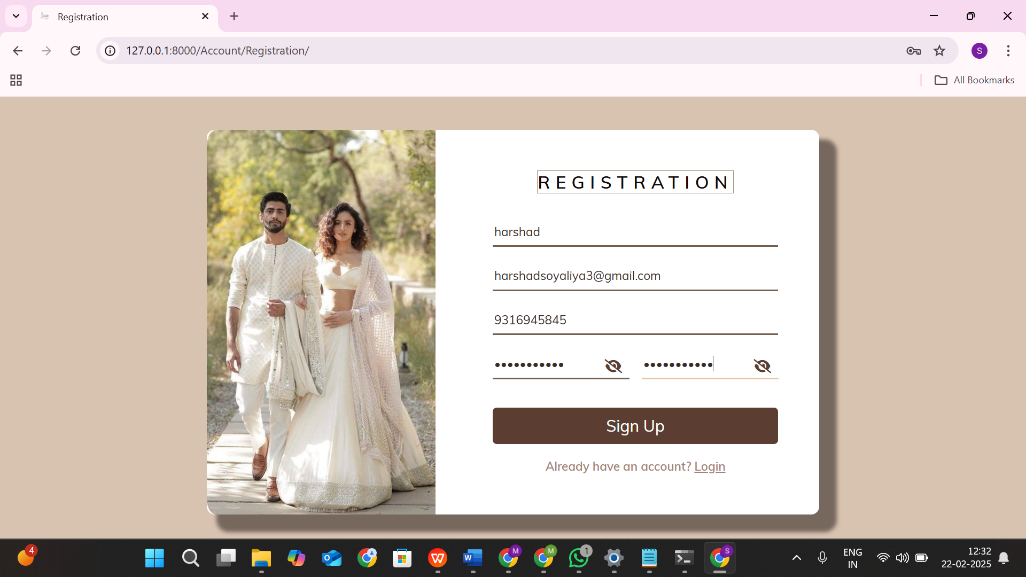
Registration Page
31

Slide 33
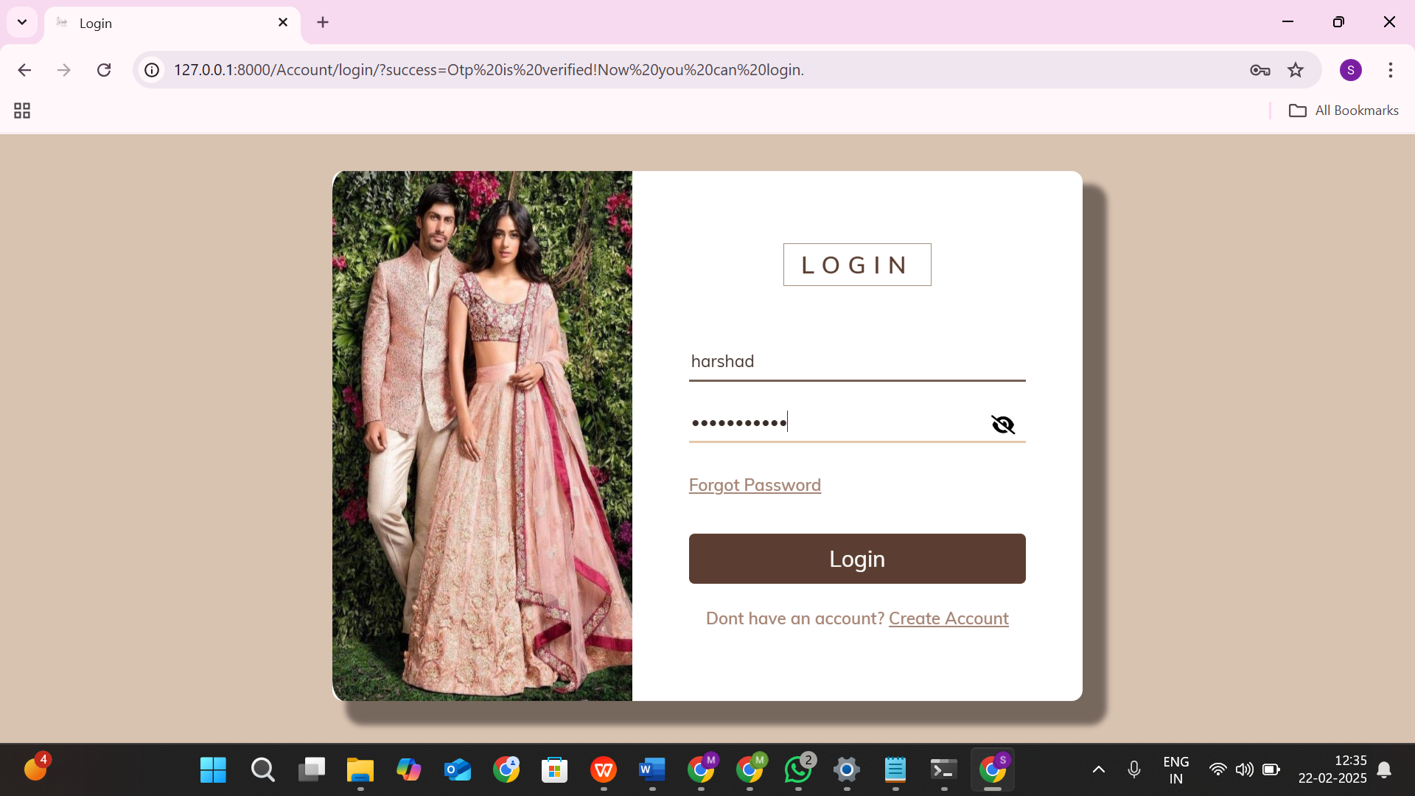
Login
32

Slide 34
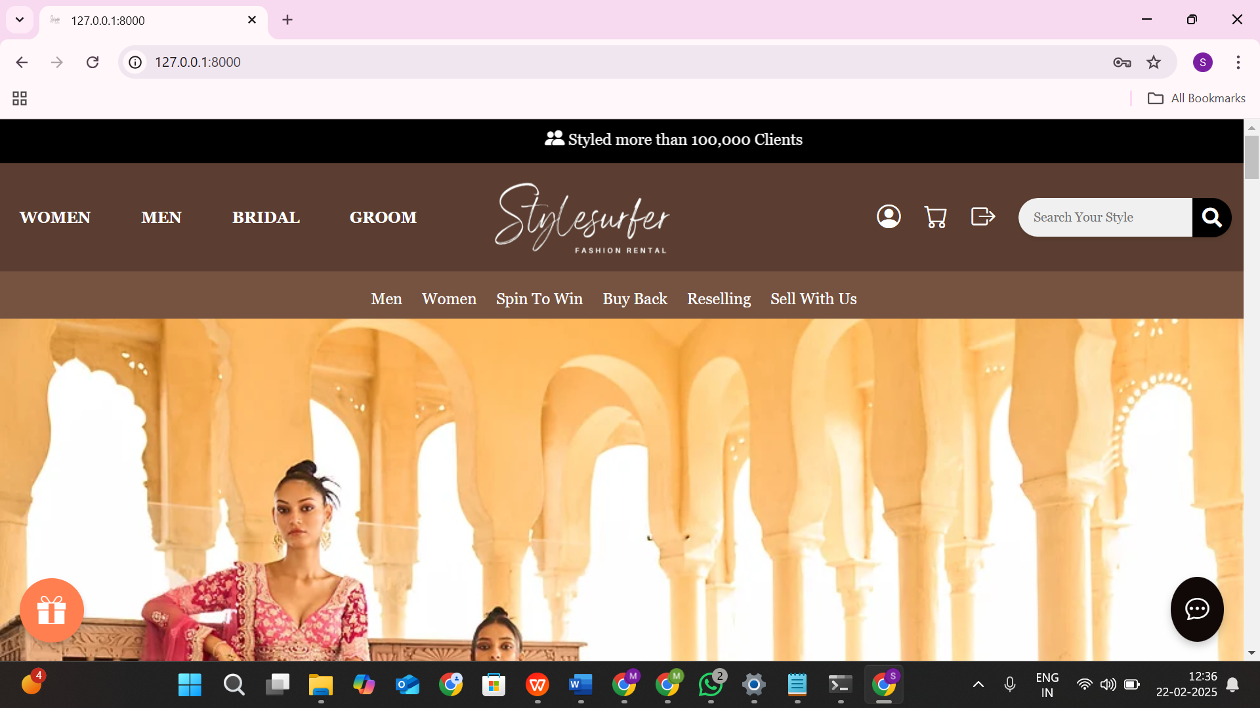
Home Page
33

Slide 35
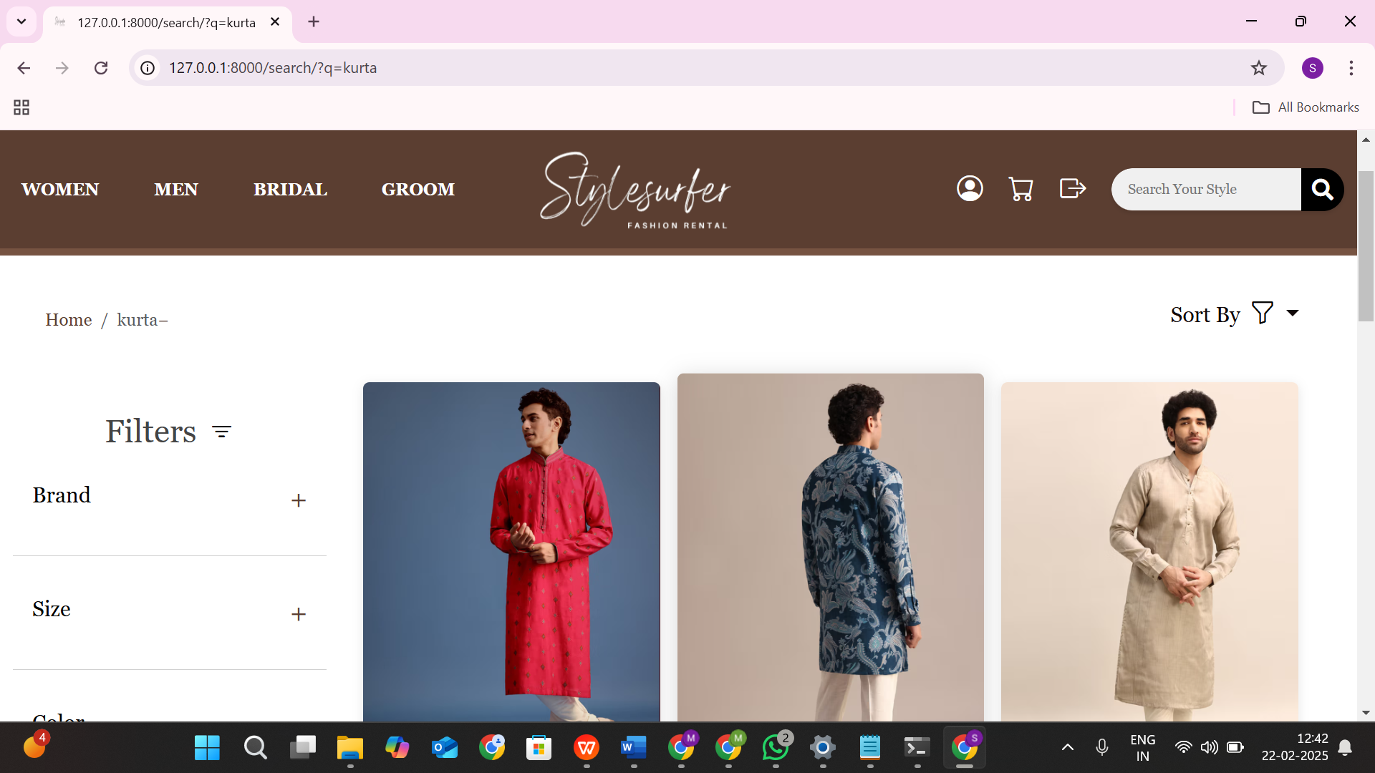
Product Page
34

Slide 36
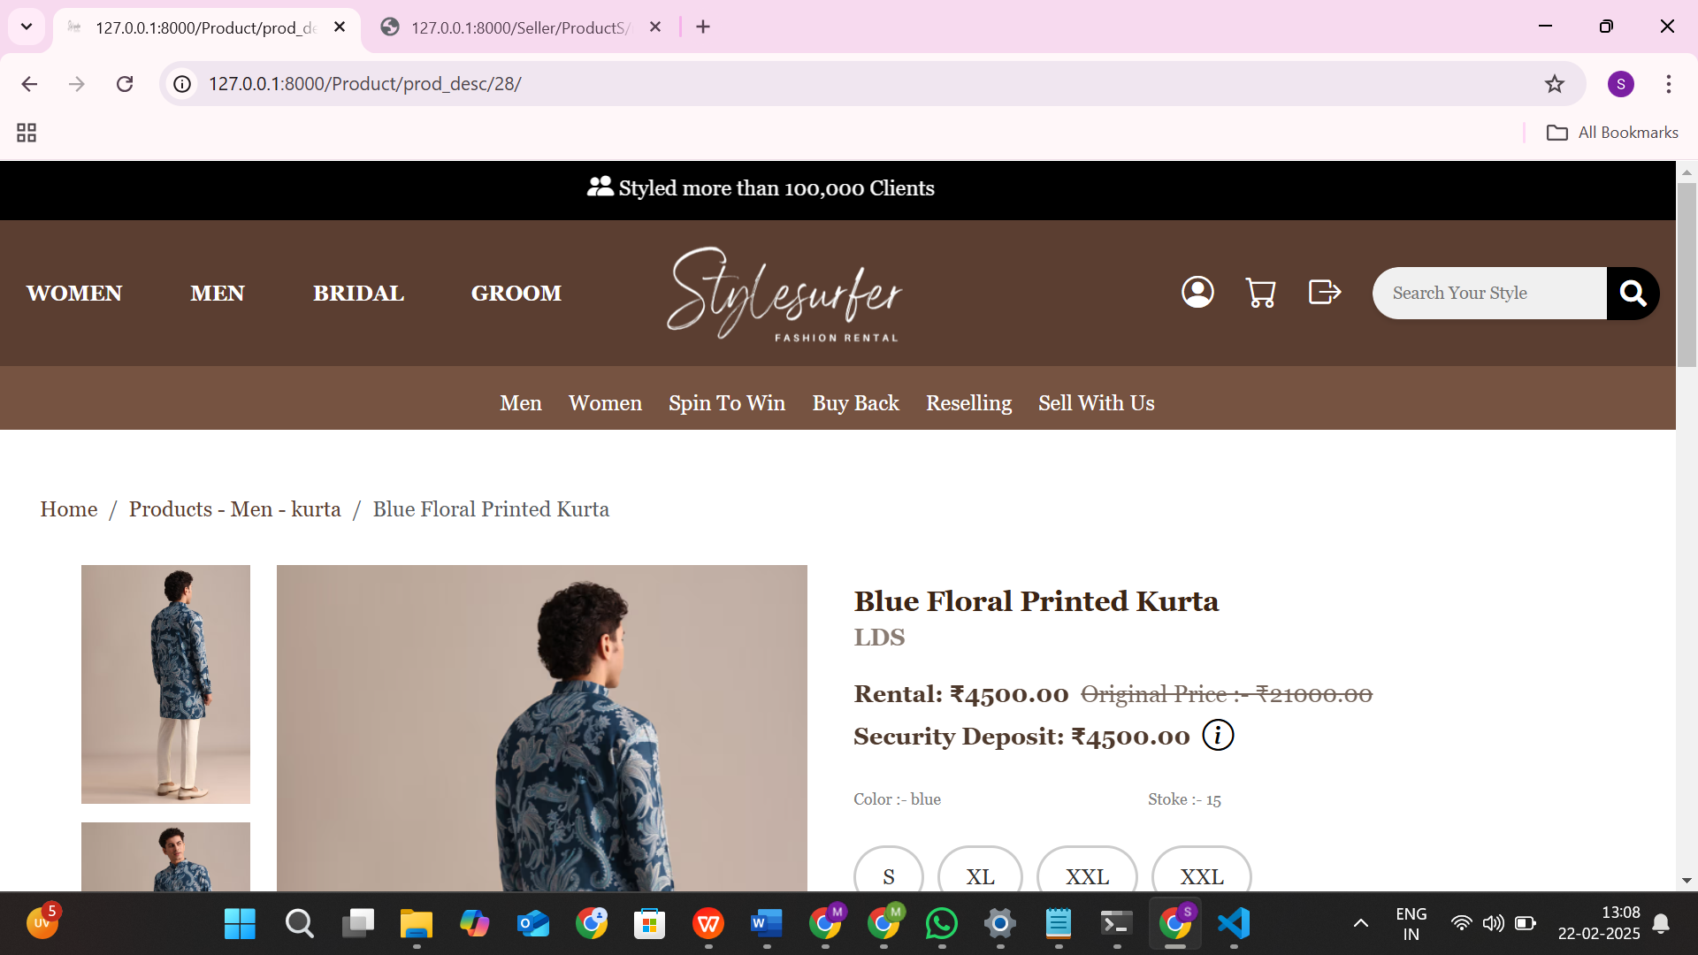
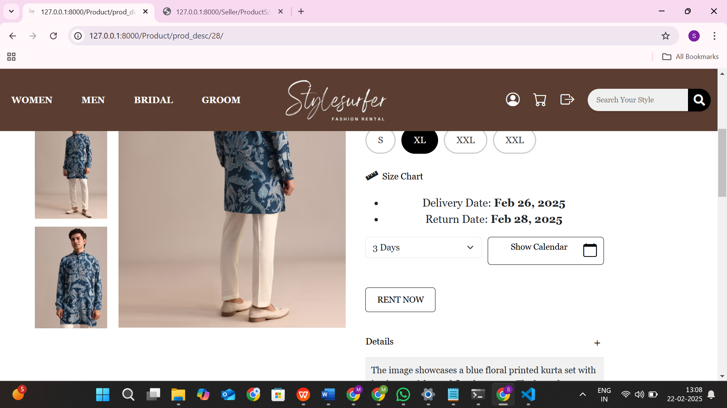
Product Description Page
35

Slide 37
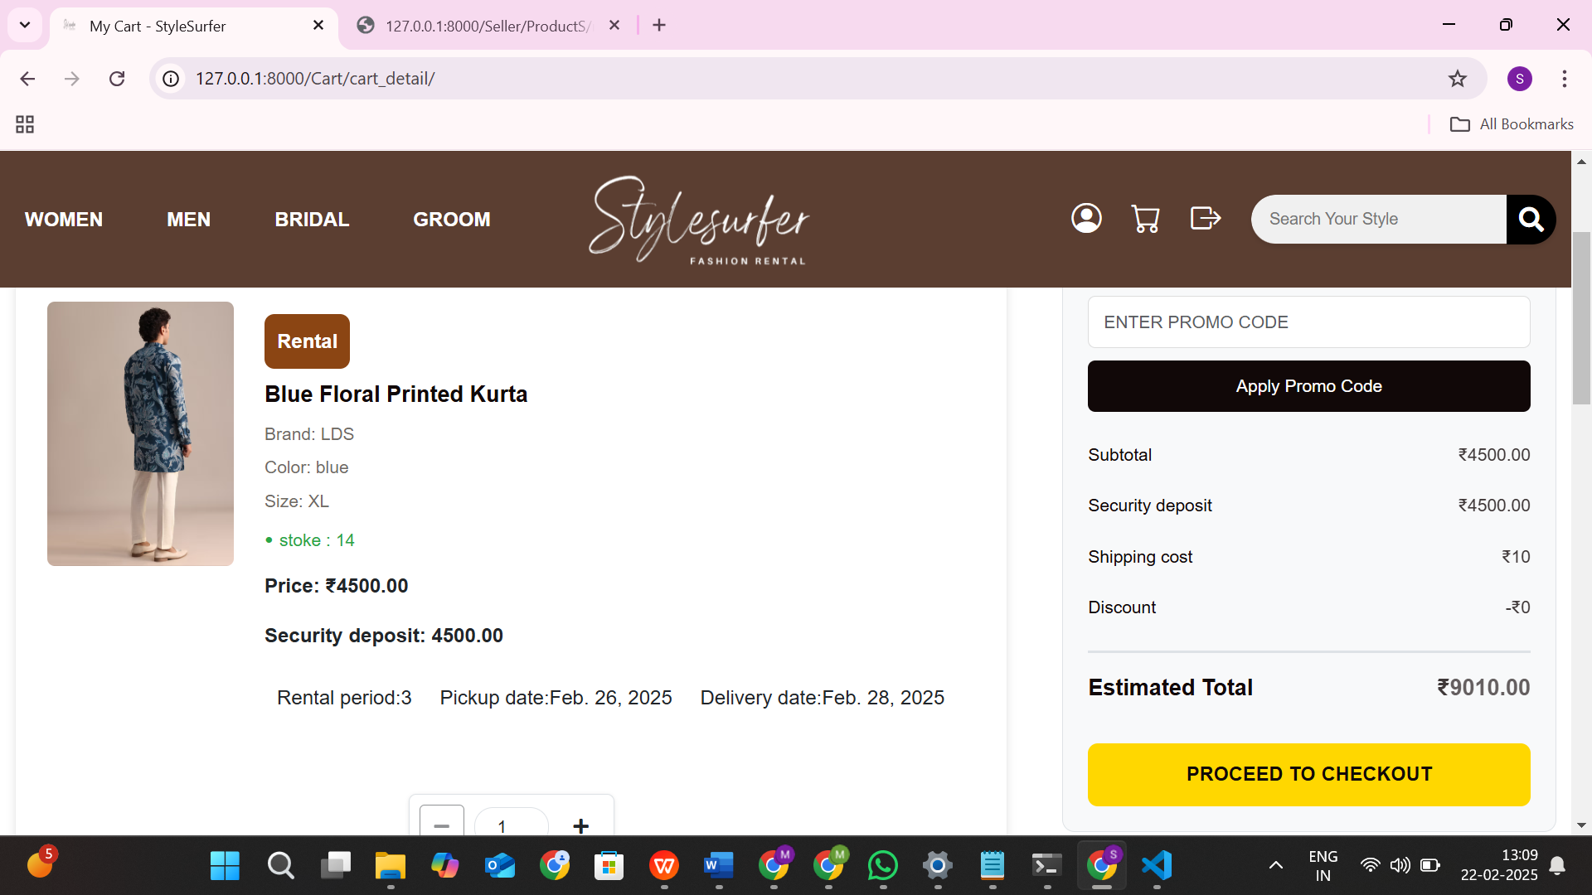
Cart Page
36

Slide 38
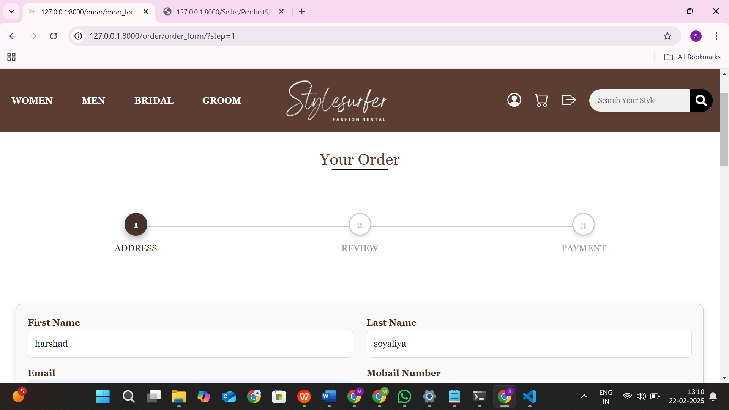
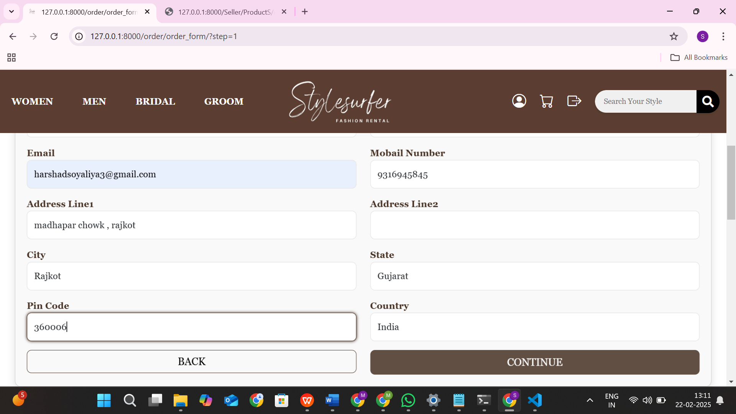
Order Page
37

Slide 39
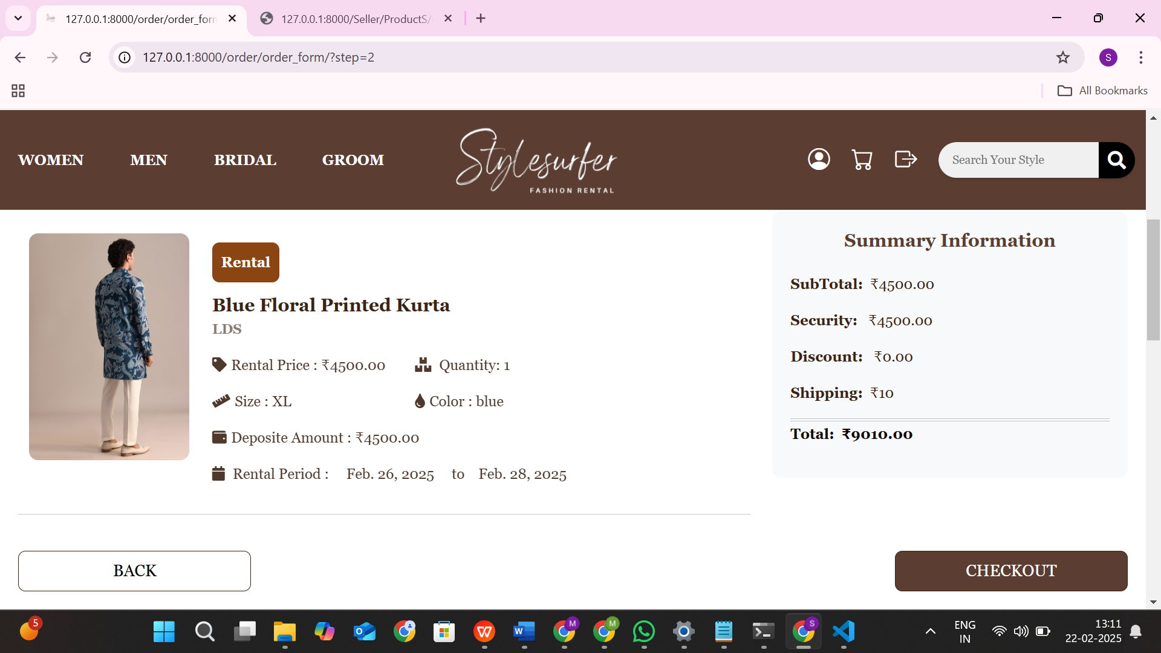
Order Page
38

Slide 40
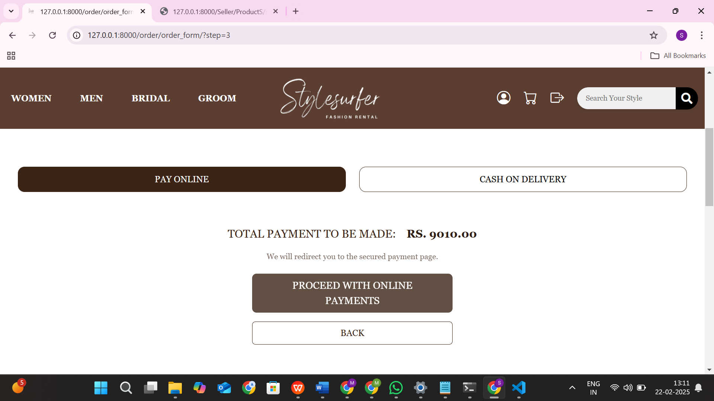
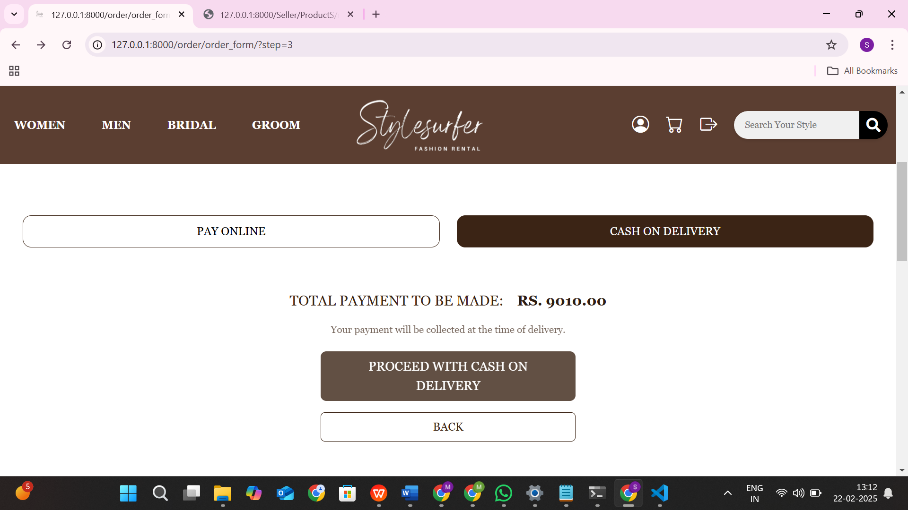
Order Page
39

Slide 41
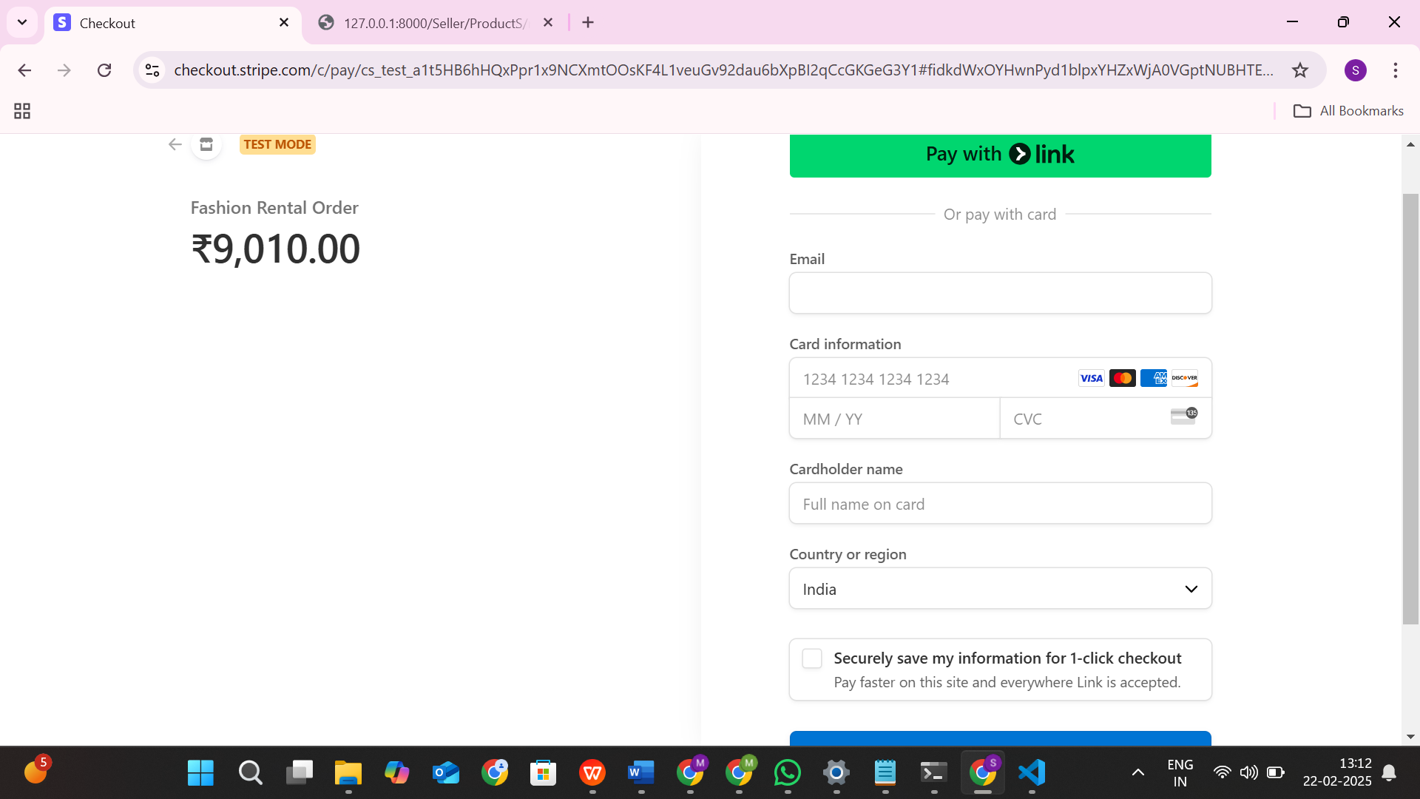
Stripe Online Payment Page
40

Slide 42
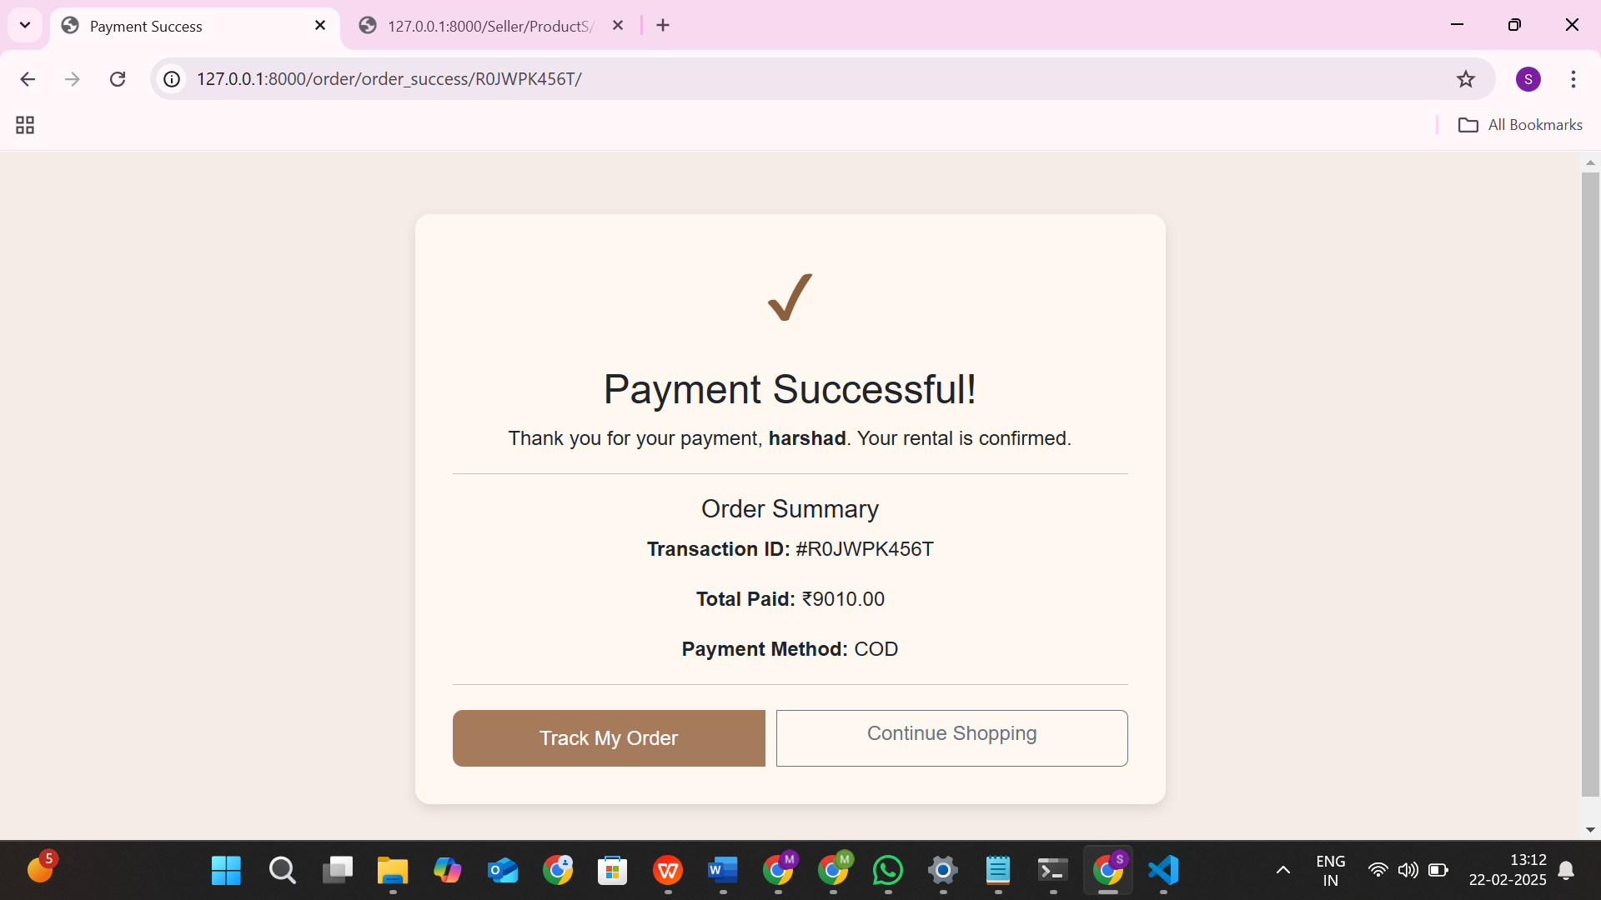
Success Page
41

Slide 43
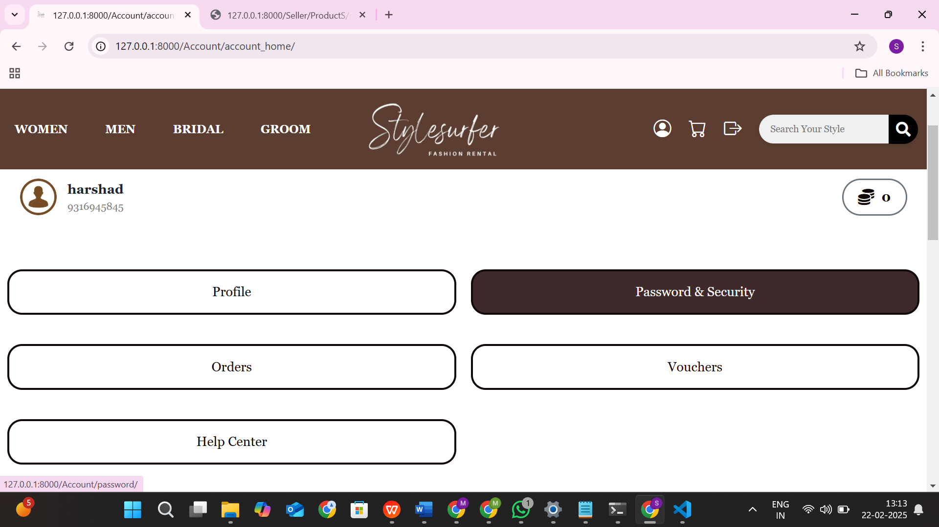
Account Section Page
42

Slide 44
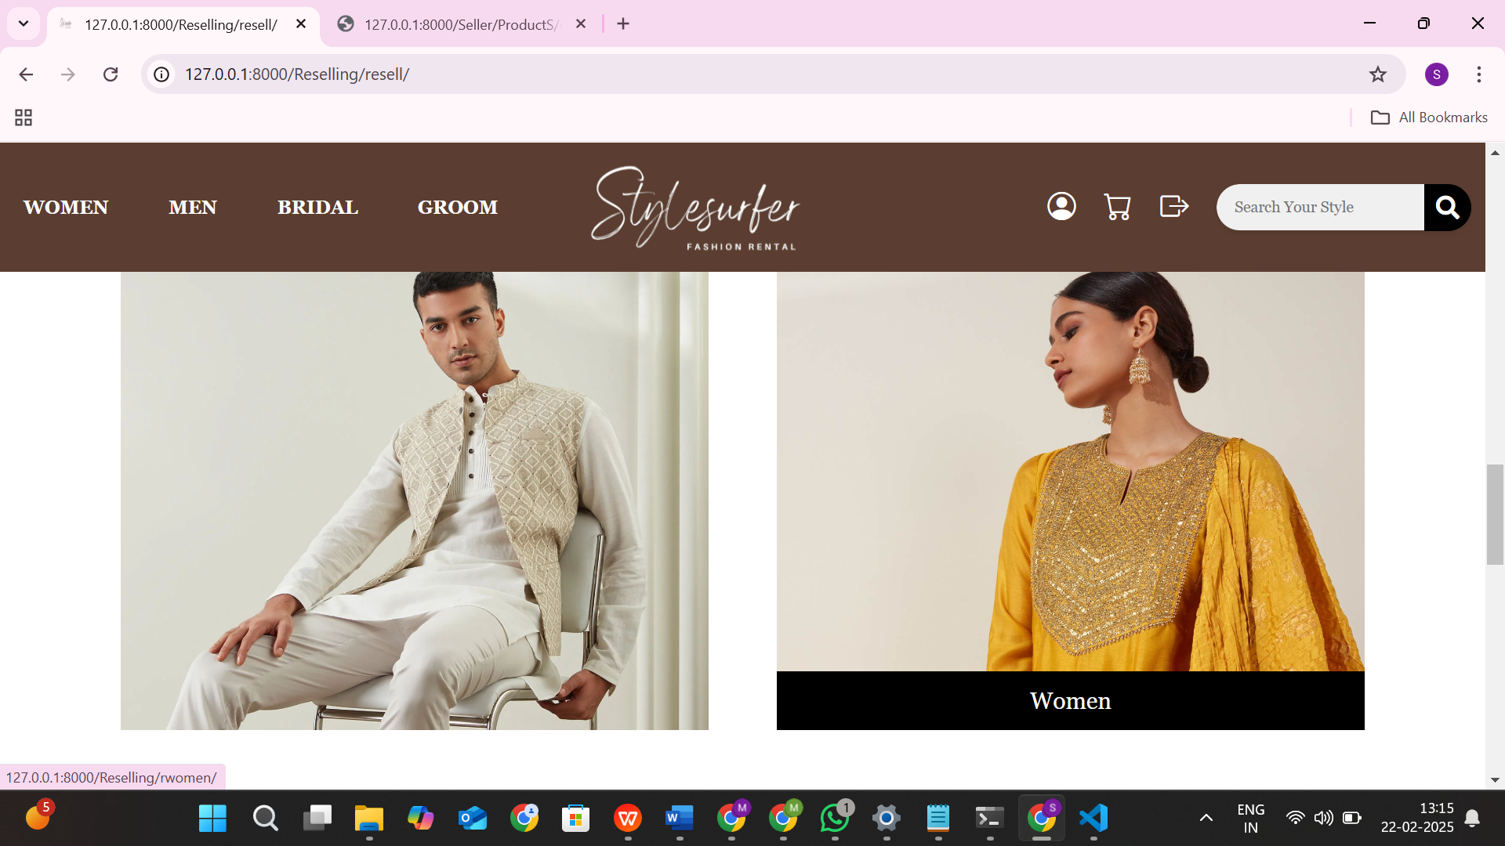
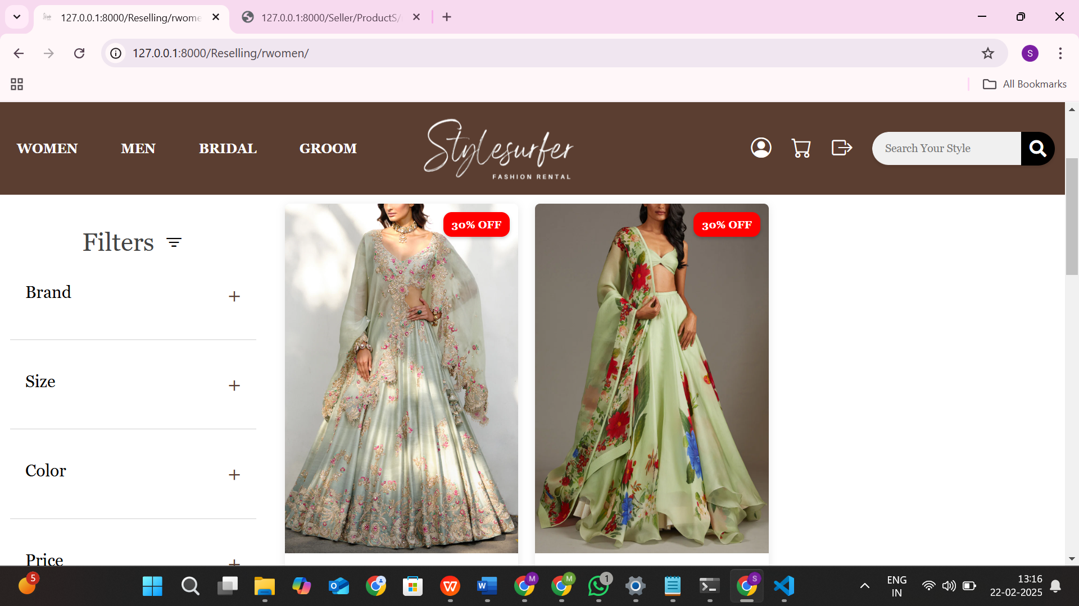
Reselling Page
43

Slide 45
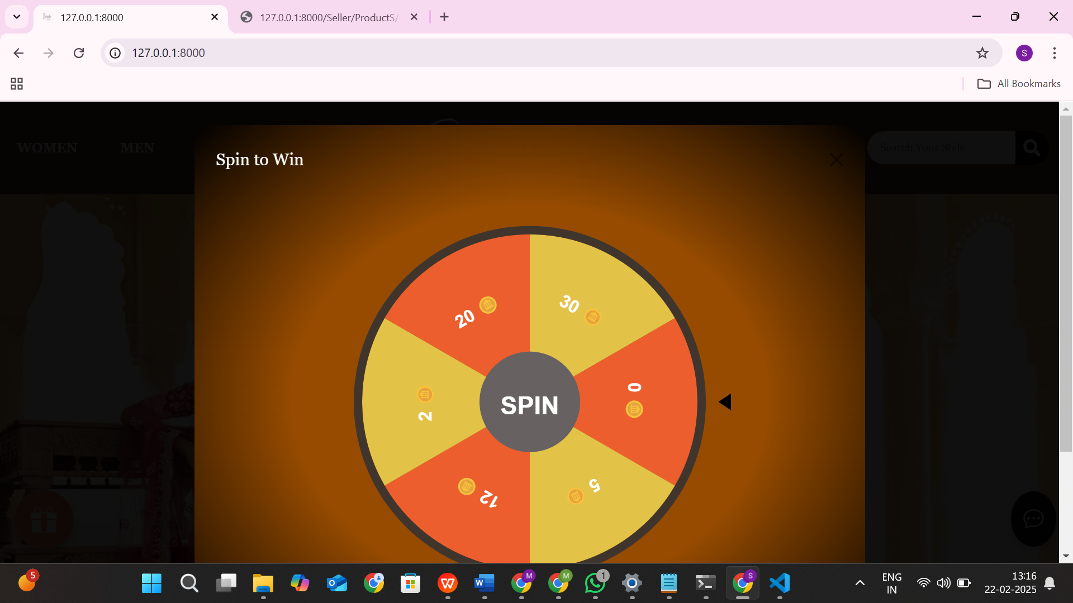
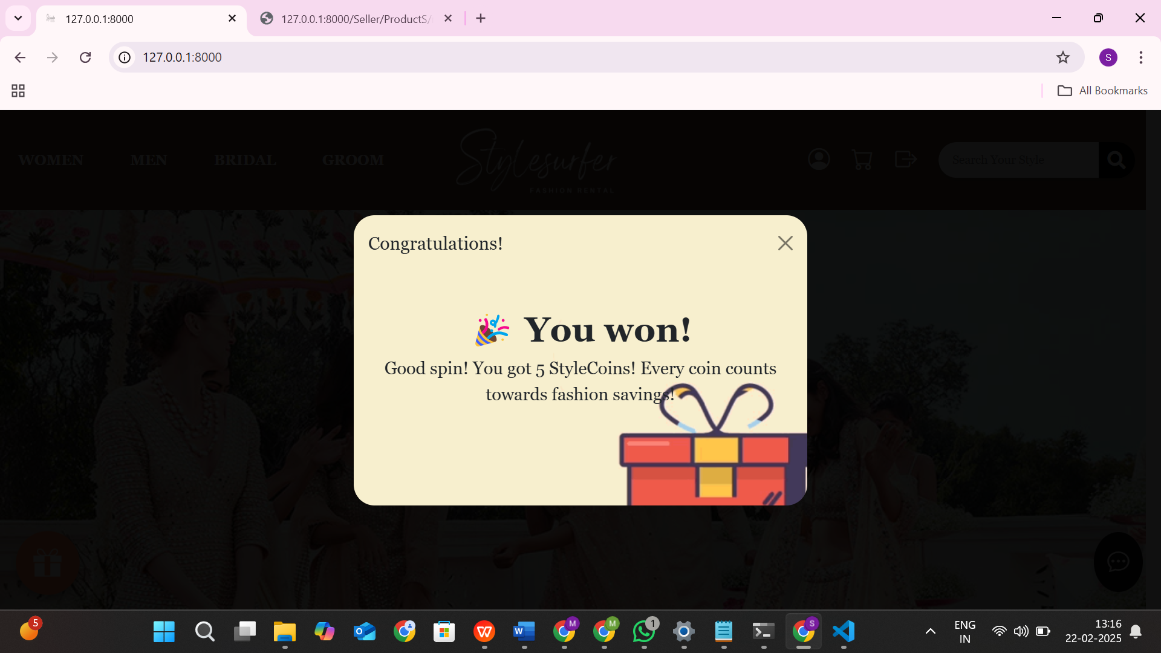
Spin To Win Page
44

Slide 46
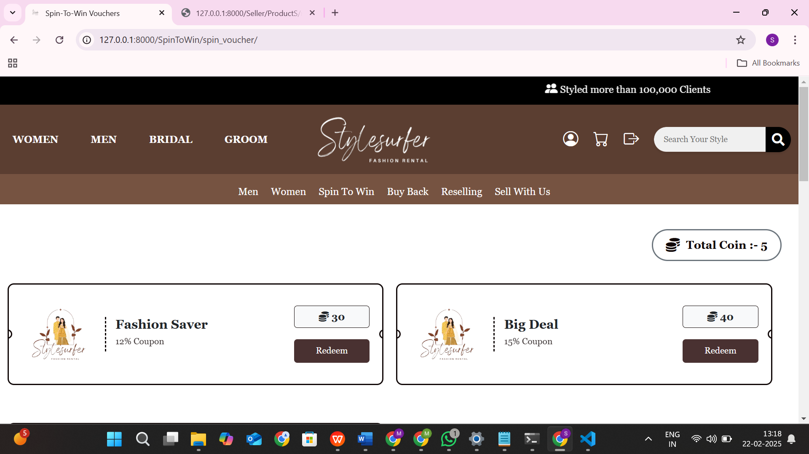
Spin To Win Page
45

Slide 47
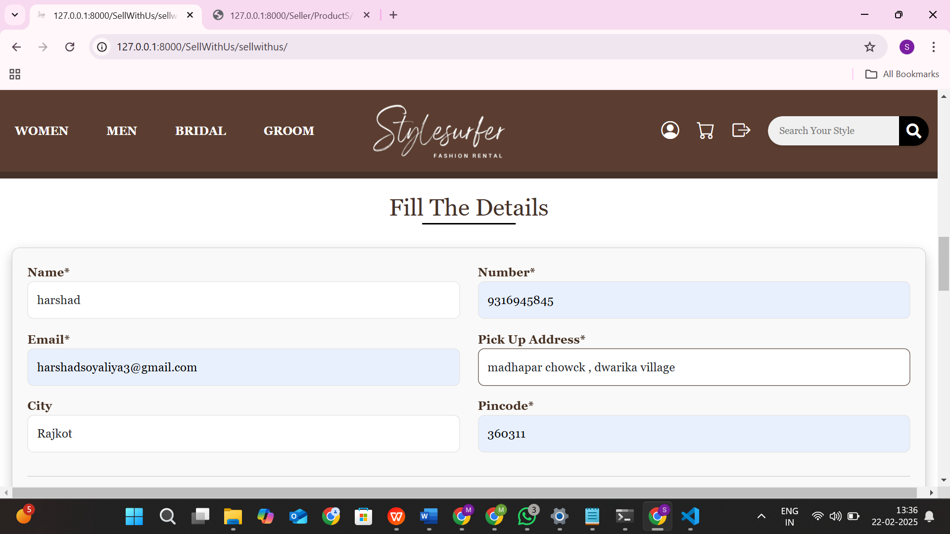
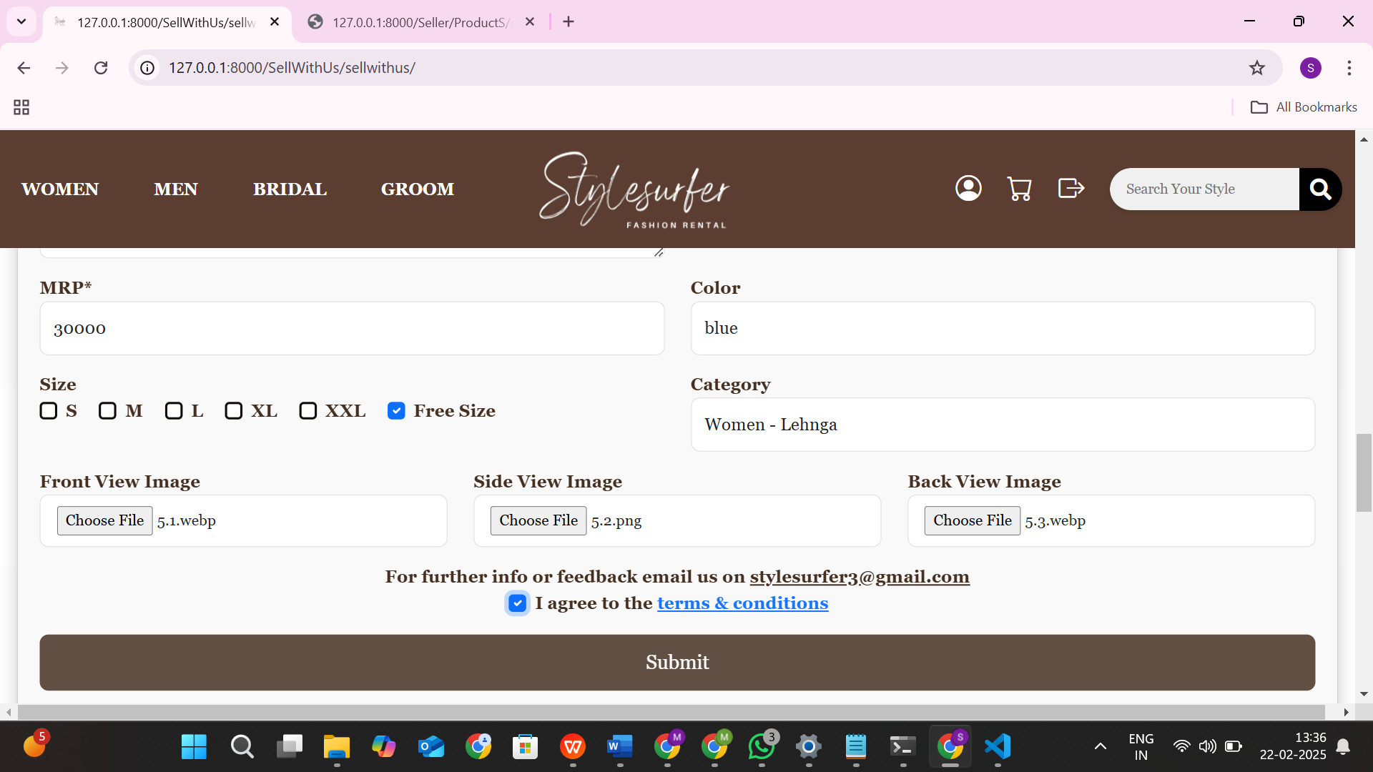
Sell With Us Page
46

Slide 48
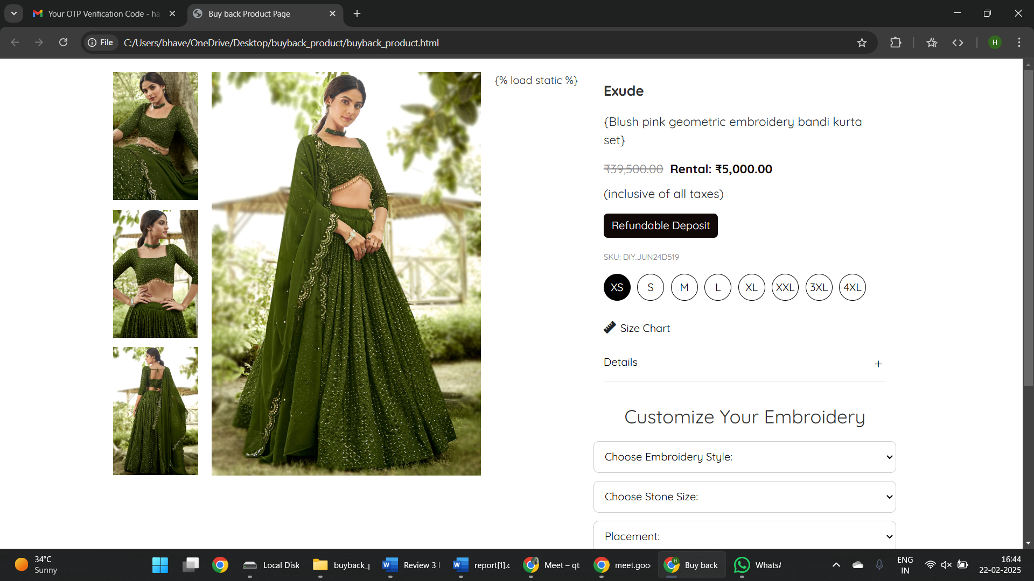
Buy Back Page
47

Slide 49
Seller Site
48

Slide 50
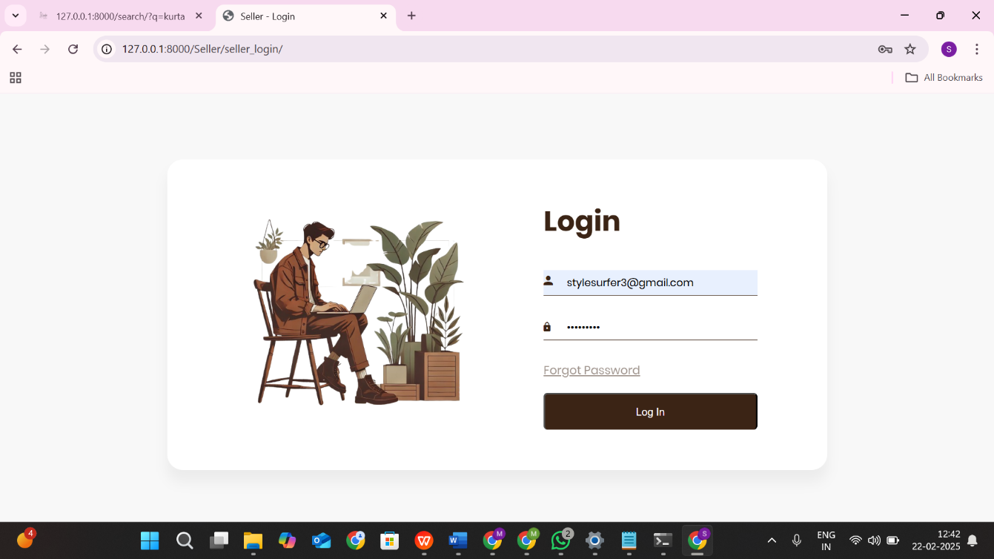
Login Page
49

Slide 51
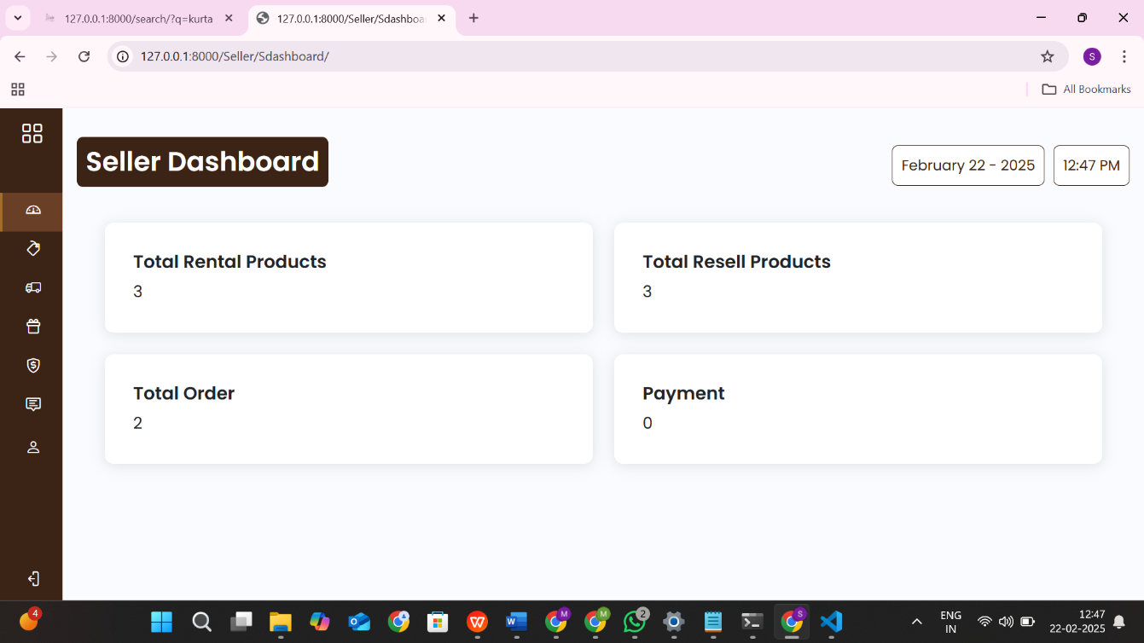
Dashboard Page
50

Slide 52
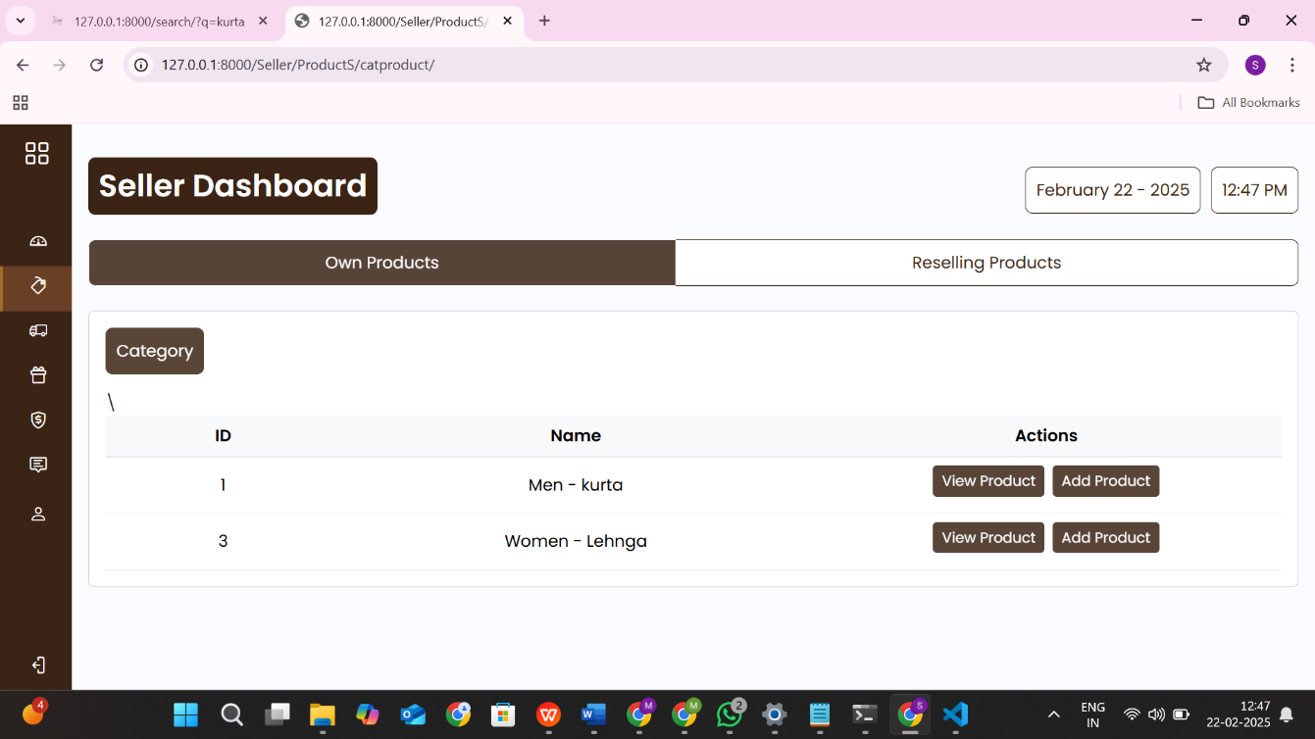
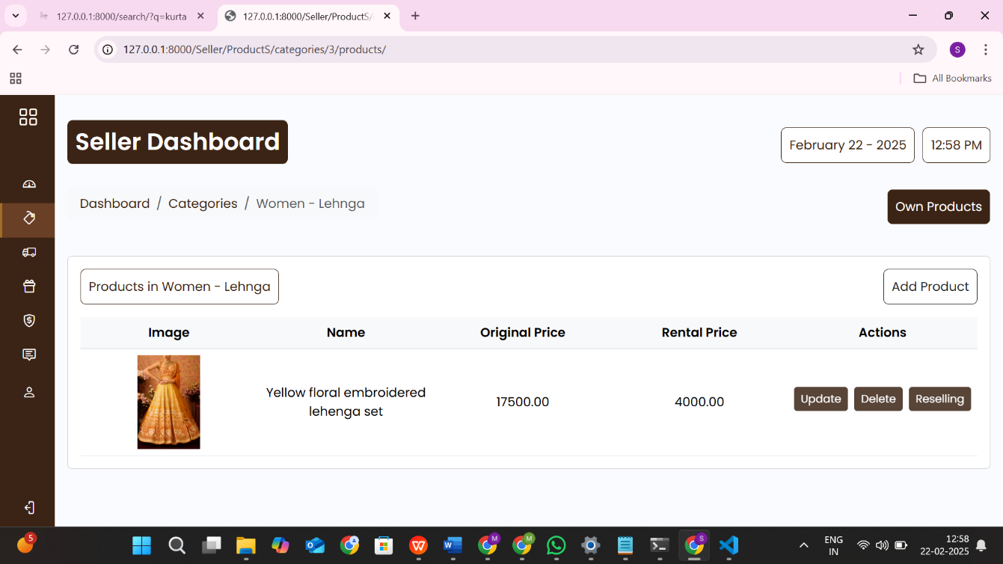
Product view Page
51

Slide 53
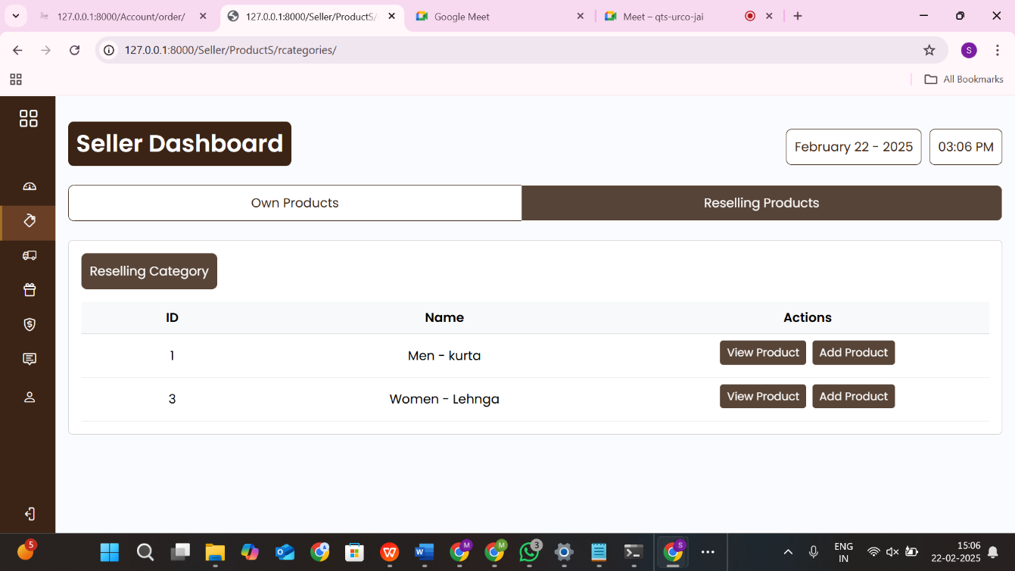
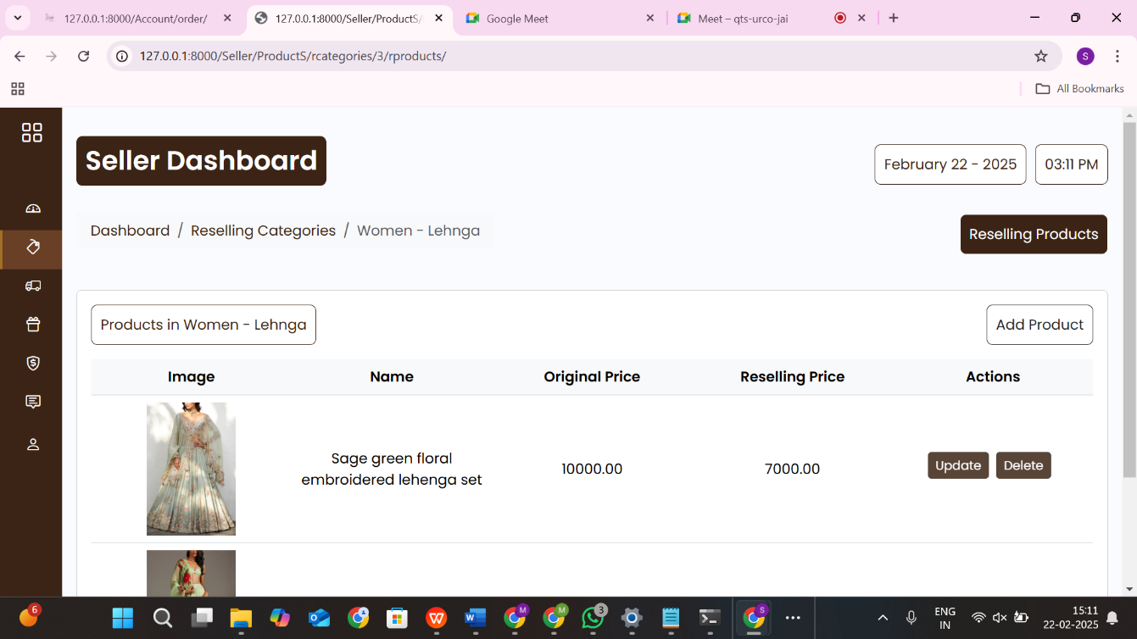
Resell Product view Page
52

Slide 54
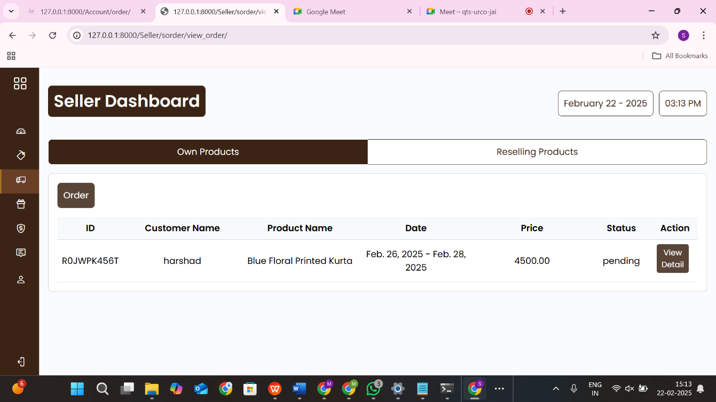
Order view Page
53

Slide 55
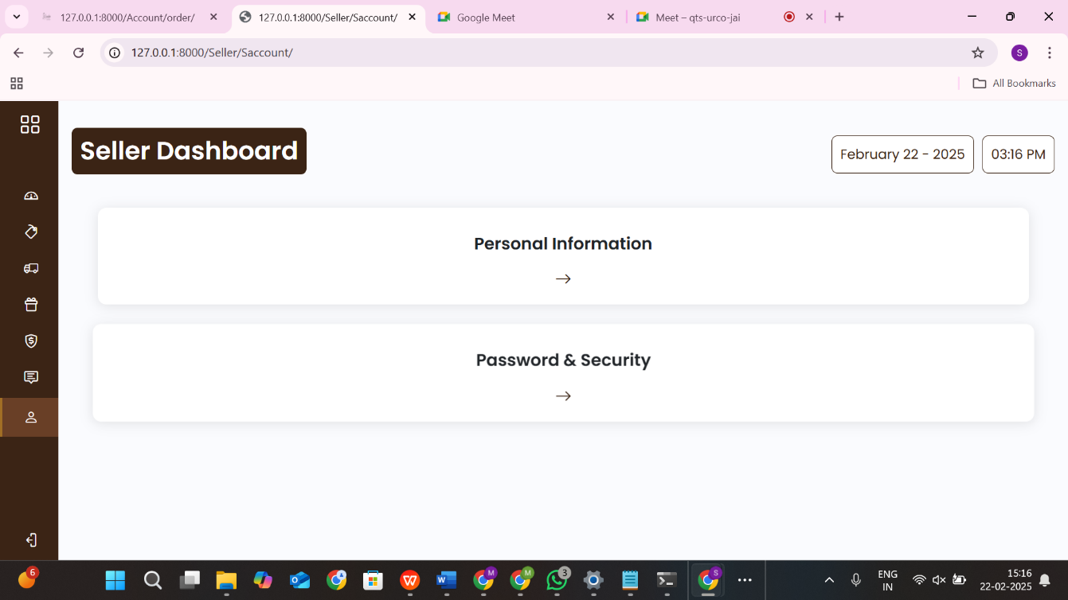
Account Page
54

Slide 56
Delivery Partner Site
55

Slide 57
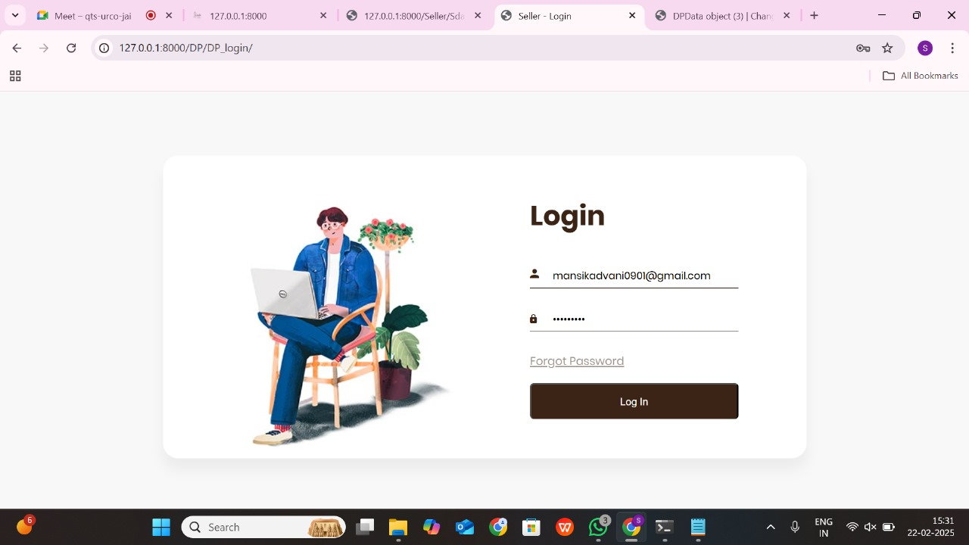
Login Page
56

Slide 58
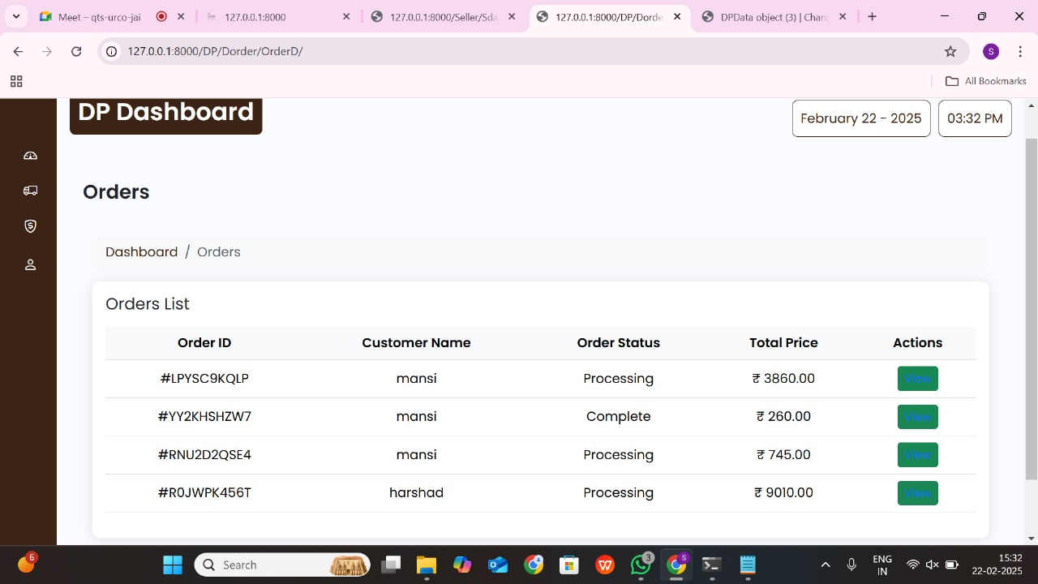
View Orders Page
57

Slide 59
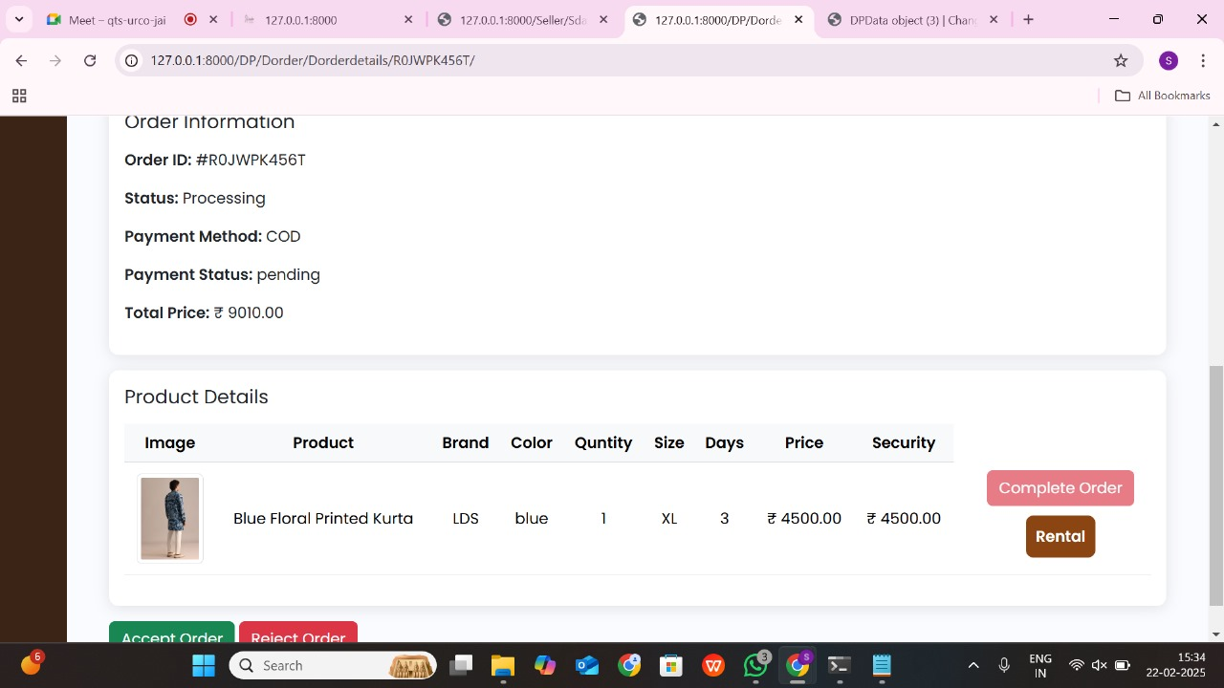
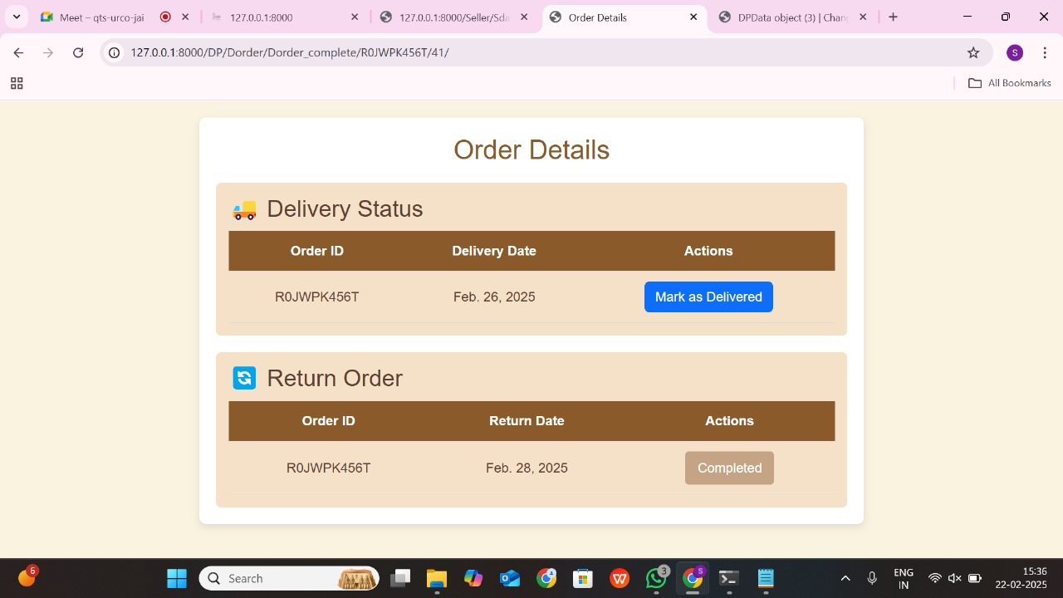
View Order detail Page
58

Slide 60
Account Page
59

Slide 61
Admin Site
60

Slide 62
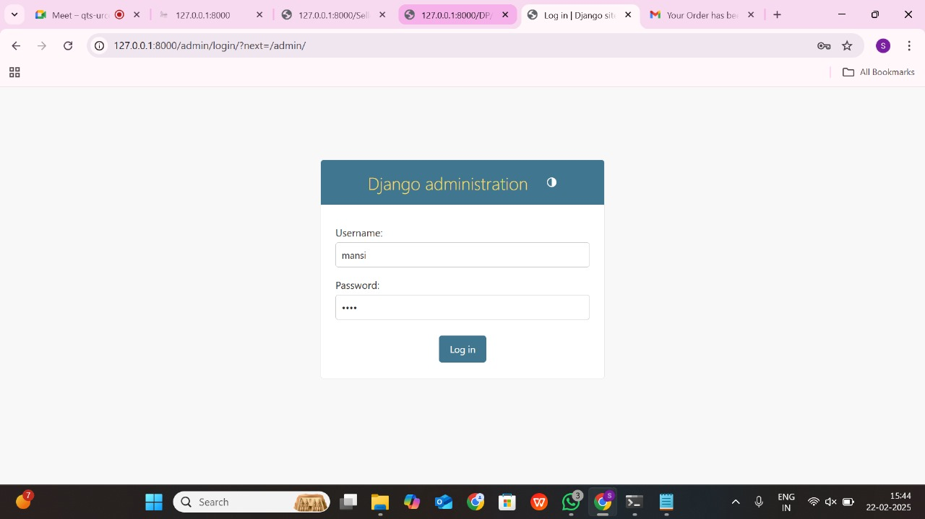
Login Page
61

Slide 63
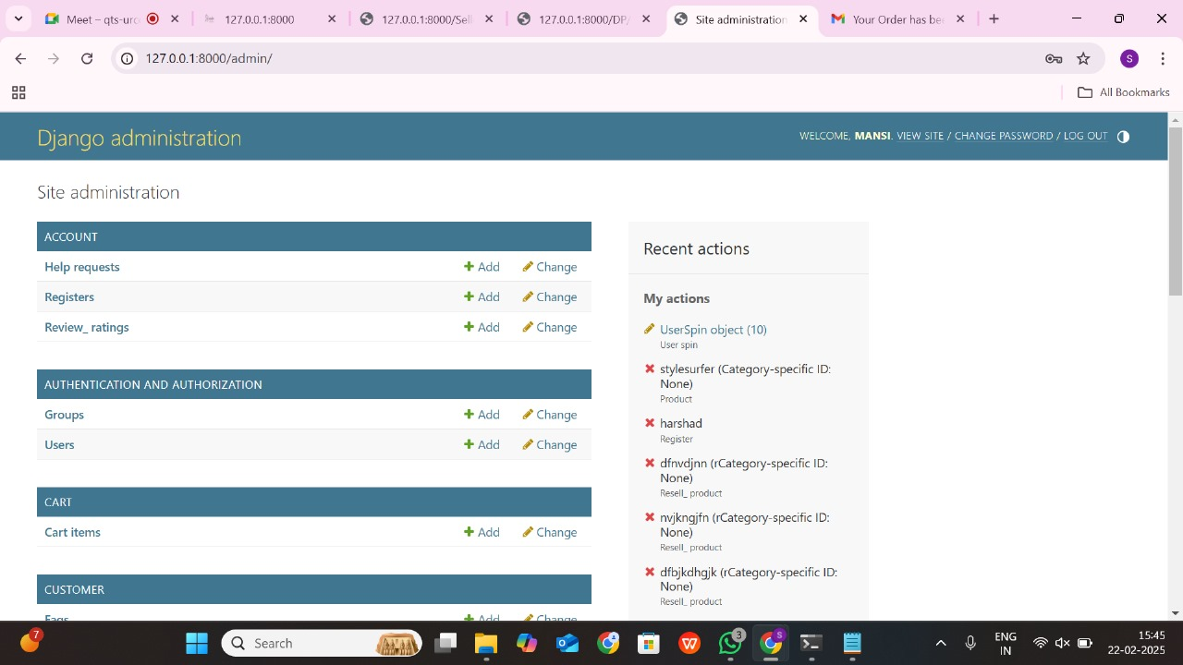
Dashboard Page
62

Slide 64
Customer Benefits Through Low-Cost & Unique Features : affordable rentals and features like Buy-Back, Spin-to-Win, and Reselling made the platform more appealing. These features provided cost-effective fashion choices, enhancing the overall value for customers.
Well-Structured Website Management & Positive Response : The project demonstrated how an efficiently managed fashion rental platform can provide a smooth user experience. The planned structure and functionalities received positive feedback from those who reviewed the project.
63

Slide 65
Effective Service : The platform's design ensured that customers, sellers, and delivery partners could easily access the services they needed.
User-Friendly Seller Dashboard & Positive Feedback from Delivery Management : The seller dashboard was designed to be intuitive, allowing sellers to list products, view orders, and manage earnings effortlessly. Similarly, the delivery management system ensured easy order tracking and status updates, making the platform efficient from a logistics perspective.
64

Slide 66
Future Plans
65

Slide 67
We will plan to either launch the website as a real business or sell the business to a fashion company
Add more customization options so customer can have more options to personalized their outfits And Partner with more designers and brands to offer a wider collection
We will introduce the 360 degree product view or if possible we also want to introduce virtual try on feature by AR , so customer can see how outfits looks before renting.
66

Slide 68
Conclusion
StyleSurfer makes fashion affordable, stylish, and eco-friendly. With unique features and a smooth user experience, it has the potential to change the way people shop for fashion.
67

Slide 69
Thank You!
68

